Slide 1



Omar Mohamed
MAVEN ANALYTICS, LLC
CERTIFICATE OF COMPLETION
HAS SUCCESSFULLY COMPLETED
MySQL Data Analysis
October 31, 2024
8.0 CPE CREDITS
INFORMATION TECHNOLOGY
National Registry of CPE Sponsors Number 146057 Instructional Delivery Method: QAS Self Study
Chris Dutton [Founder, Maven Analytics]
Maven Analytics, 200 Portland St, Boston, MA 02114
In accordance with the standards of the National Registry Of CPE Sponsors, CPE credits have been granted based on a 50-minute hour.
Credential ID: 121120429

Slide 2
INTRODUCING THE FINAL COURSE PROJECT
You and your business partner were recently approached by another local business owner who is interested in purchasing Maven Movies. He primarily owns restaurants and bars, so he has lots of questions for you about your business and the rental business in general. His offer seems very generous, so you are going to entertain his questions.
THE
SITUATION
THE
OBJECTIVE
Use MySQL to:
Leverage your SQL skills to extract and analyze data from various tables in the Maven
Movies database to answer your potential Acquirer’s questions. Each question will require
you to write a multi-table SQL query, joining at least two tables.

Slide 3
INTRODUCING THE FINAL COURSE PROJECT
THE
SITUATION
Dear Maven Movies Management,
I am excited about the potential acquisition and learning more
about your rental business.
Please bear with me as I am new to the industry, but I have a number of questions for you. Assuming you can answer them all, and that there are no major surprises, we should be able to move forward with the purchase.
Best,
Martin Moneybags

Slide 4


INTRODUCING THE FINAL COURSE PROJECT
1
My partner and I want to come by each of the stores in person and meet the managers. Please send over
the managers’ names at each store, with the full address of each property (street address, district, city, and
country please).
2
I would like to get a better understanding of all of the inventory that would come along with the business. Please pull together a list of each inventory item you have stocked, including the store_id number, the inventory_id, the name of the film, the film’s rating, its rental rate and replacement cost.
3
From the same list of films you just pulled, please roll that data up and provide a summary level overview of your inventory. We would like to know how many inventory items you have with each rating at each store.
4
Similarly, we want to understand how diversified the inventory is in terms of replacement cost. We want to
see how big of a hit it would be if a certain category of film became unpopular at a certain store.
We would like to see the number of films, as well as the average replacement cost, and total replacement cost, sliced by store and film category.

Slide 5
INTRODUCING THE FINAL COURSE PROJECT
5
My partner and I want to come by each of the stores in person and meet the managers. Please send over
the managers’ names at each store, with the full address of each property (street address, district, city, and
country please).
6
My partner and I want to come by each of the stores in person and meet the managers. Please send over
the managers’ names at each store, with the full address of each property (street address, district, city, and
country please).
7
My partner and I want to come by each of the stores in person and meet the managers. Please send over
the managers’ names at each store, with the full address of each property (street address, district, city, and
country please).
8
My partner and I want to come by each of the stores in person and meet the managers. Please send over
the managers’ names at each store, with the full address of each property (street address, district, city, and
country please).

Slide 6
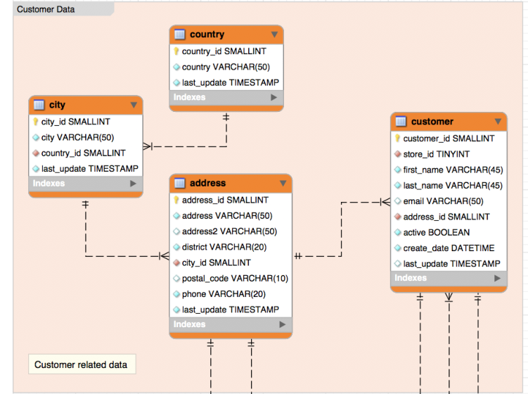
*Copyright 2019, Excel Maven & Maven Analytics, LLC

Slide 7
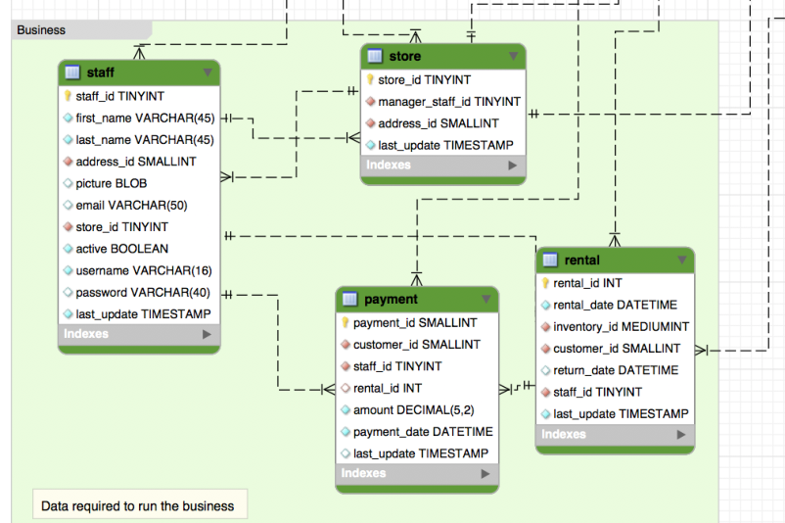

Slide 8
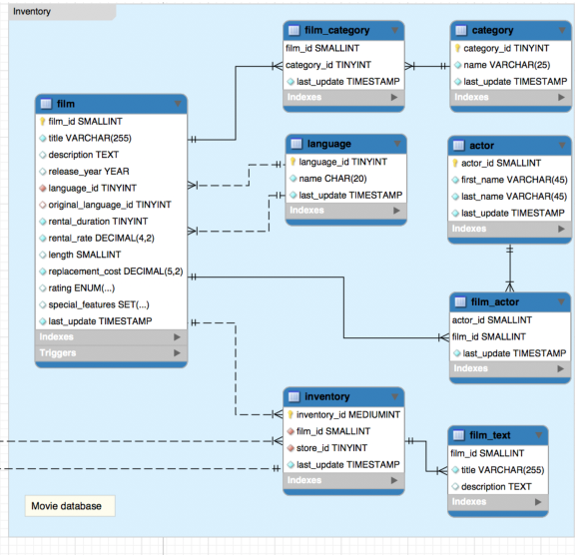

Slide 9
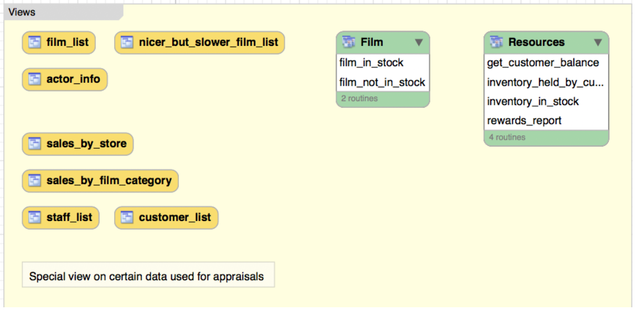

Slide 10
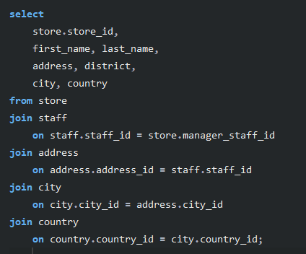
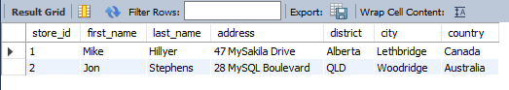
Answers
1
My partner and I want to come by each of the stores in person and meet the managers. Please send over
the managers’ names at each store, with the full address of each property (street address, district, city, and
country please).

Slide 11
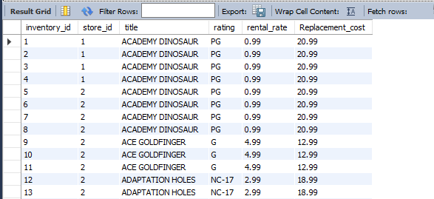
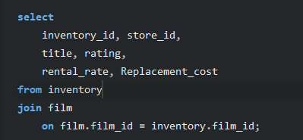
Answers
2
I would like to get a better understanding of all of the inventory that would come along with the business. Please pull together a list of each inventory item you have stocked, including the store_id number, the inventory_id, the name of the film, the film’s rating, its rental rate and replacement cost.

Slide 12
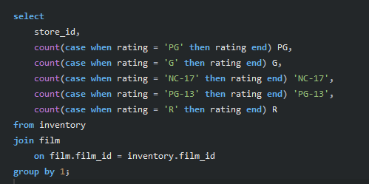
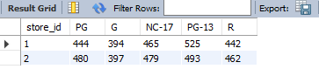
Answers
3
From the same list of films you just pulled, please roll that data up and provide a summary level overview of your inventory. We would like to know how many inventory items you have with each rating at each store.

Slide 13
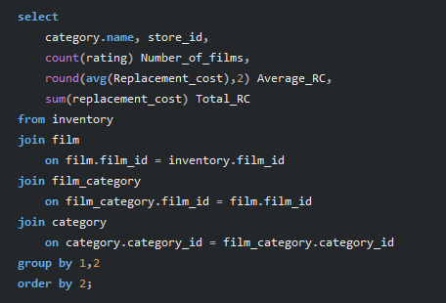
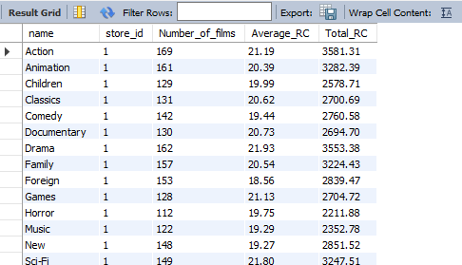
Answers
4
Similarly, we want to understand how diversified the inventory is in terms of replacement cost. We want to
see how big of a hit it would be if a certain category of film became unpopular at a certain store.
We would like to see the number of films, as well as the average replacement cost, and total replacement cost, sliced by store and film category.

Slide 14
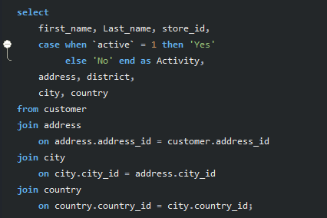
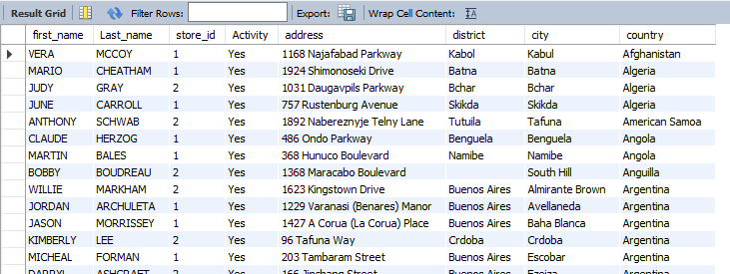
Answers
5
We want to make sure you folks have a good handle on who your customers are. Please provide a list of all customer names, which store they go to, whether or not they are currently active, and their full addresses – street address, city, and country.

Slide 15
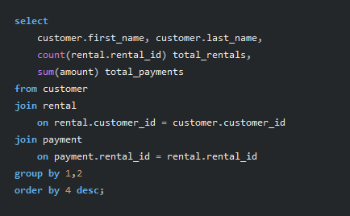
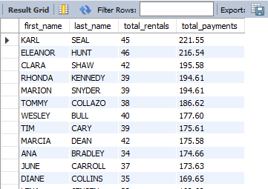
Answers
6
We would like to understand how much your customers are spending with you, and also to know who your most valuable customers are. Please pull together a list of customer names, their total lifetime rentals, and the sum of all payments you have collected from them. It would be great to see this ordered on total lifetime value, with the most valuable customers at the top of the list.

Slide 16
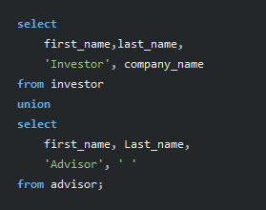
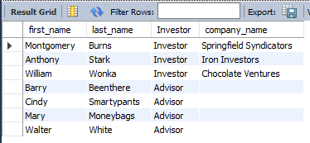
Answers
7
My partner and I would like to get to know your board of advisors and any current investors. Could you please provide a list of advisor and investor names in one table? Could you please note whether they are an investor or an advisor, and for the investors, it would be good to include which company they work with.

Slide 17
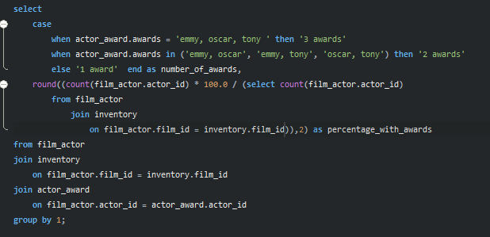
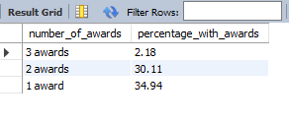
Answers
8
We're interested in how well you have covered the most-awarded actors. Of all the actors with three types of awards, for what % of them do we carry a film? And how about for actors with two types of awards? Same questions. Finally, how about actors with just one award?

Slide 18
THANK YOU!

